Slide 1
Modern Block Cipher

Slide 2
Block Cipher
Is an encryption/decryption scheme in which a block of plaintext is treated as a whole and used to produce a ciphertext block of equal length
  typical size: 64 bits
  most modern ciphers are block ciphers
Block ciphers have a Fiestel structure, consists of number of identical rounds
Each round a substitution is performed followed by a permutation

Slide 3
Block vs Stream Ciphers
block ciphers process messages in blocks, each of which is then en/decrypted
like a substitution on very big characters
  64-bits or more
stream ciphers process messages a bit or byte at a time when en/decrypting
many current ciphers are block ciphers
  better analyzed
  broader range of applications

Slide 4
Block Cipher Principles
most symmetric block ciphers are based on a Feistel Cipher Structure
needed since must be able to decrypt ciphertext to recover messages efficiently
block ciphers look like an extremely large substitution
would need table of 2⁶⁴ entries for a 64-bit block
instead create from smaller building blocks
using idea of a product cipher

Slide 5
Claude Shannon-Substitution-Permutation Ciphers
provide confusion & diffusion of message & key
Confusion & diffusion are needed to design secure cryptographic systems
The simplest way to achieve both diffusion and confusion is to use a substitution-permutation network

Slide 6
Claude Shannon and Substitution-Permutation networks
Claude Shannon introduced idea of substitution-permutation (S-P) networks in 1949 paper
form basis of modern block ciphers
Takes a block of the plaintext and the key as inputs, and applies several alternating "rounds" or "layers" of substitution boxes (S-boxes) and permutation boxes (P-boxes) to produce the ciphertext block
S-P nets are based on the two primitive cryptographic operations seen before:
  substitution (S-box)
  permutation (P-box)
provide confusion & diffusion of message & key

Slide 7
S-box
An S-box substitutes a small block of bits (the input of the S-box) by another block of bits (the output of the S-box).
This substitution should be one-to-one, to ensure invertibility (hence decryption)
A good S-box->changing one input bit will change about half of the output bits
Each output bit will depend on every input bit

Slide 8
P-Box
A P-box is a permutation of all the bits
It takes the outputs of all the S-boxes of one round, permutes the bits, and feeds them into the S-boxes of the next round

Slide 9
Confusion and Diffusion
Claude Shannon theoretically deduced the two principles that should be followed to design secure cryptographic systems
principles aim at thwarting cryptanalysis based on known statistical properties of the plaintext.
combining S & P elements to obtain:
Diffusion – It’s the property that the statistics structure of the plaintext is dissipated into long range statistics of the ciphertext
Confusion – confusion makes the relation between the key and the ciphertext as complex as possible

Slide 10
Confusion
every letter in the key influences every letter of the ciphertext block
good confusion can only be achieved when each character of the ciphertext depends on several parts of the key, and this dependence appears to be random to the observer
Ciphers that do not offer much confusion (such as Vigen`ere cipher) arevulnerable to frequency analysis.

Slide 11
Diffusion
diffusion spreads the influence of a single plaintext letter over many ciphertext letter
more ciphertexts are needed to do a meaningful statistical attack on the cipher

Slide 12
Feistel Cipher Structure
Proposed by fiestel
Substitution & permutation/transposition performed alternatively
implements Shannon’s S-P net concept
I/p to the encryption algm->plaintext block of length 2w bits and a key K
Suppose plaintext is 64bits
i/p is divided into two halves L0 & R0,32 bit each
Two halves of data pass through ‘n’ rounds(here 16 rounds) and combine to produce ciphertext block of 64bits

Slide 13
Each round i has i/p Li-1 and Ri-1 derived from previous round & subkey Ki generated by a key scheduling algm
All rounds have same structure
Substitution is performed on the left half of the data .This is done by applying a round function’F’ to the rgt half of the data and then take XOR of the o/p of the ‘F’ func and the left half of the data
Round fuc also has an i/p K
After this substitution,a permutation is performed by interchanging the two halves of the data
Hence this structure is known as substitution-permutation network(SPN)

Slide 14
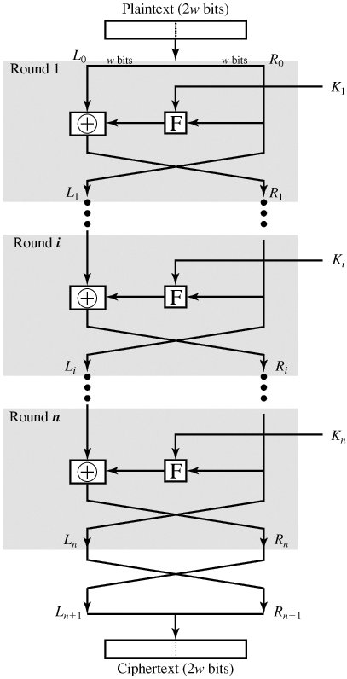

Slide 15
Decryption Algorithm
Same as encryption process
Ciphertext is used as i/p to the algm , but use the subkeys Ki in reverse order
We use Kn in the first round ,Kn-1 in the second and so on
First round of the decryption process is equal to the 16th round of encryption

Slide 16
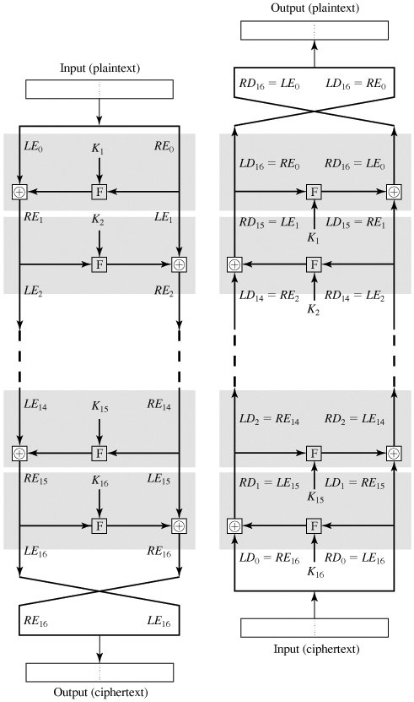

Slide 17
Parameters
Block Size: Larger block size means greater security, but reduces encryption/decryption speed.
Key size: Larger key size means greater security but may decrease encryption/decryption speed
Number of rounds: Multiple rounds offer increasing security. Typical size is 16 rounds
Subkey generation algorithm: Greater complexity in subkey generation leads to greater security
Round function: Greater complexity in round function means greater difficulty of cryptanalysis

Slide 18
To show that the output of the first round of the decryption process is equal to a 32-bit swap of the input to the sixteenth round of the encryption process. First, consider the encryption process. We see that
LE ₁₆ = RE ₁₅
RE ₁₆ = LE ₁₅ x F(RE ₁₅ , K ₁₆ )

Slide 19
On the decryption side,
LD ₁ = RD0= LE ₁₆ = RE ₁₅
RD ₁ = LD0 x F(RD0 , K ₁₆ )
= RE ₁₆ x F(RE ₁₅ , K ₁₆ )
= [LE ₁₅ x F(RE ₁₅ , K ₁₆ )] x F(RE ₁₅ , K ₁₆ )
The XOR has the following properties:
[ A x B ] x C = A x [ B x C ]
D x D = 0
E x 0 = E

Slide 20
LE _{i} = RE _{i-1}
RE _{i} =LE _{i -1} x F(RE _{i -1} , K _{i} )
Rearranging terms,
RE _{i -1} = LE _{i}
LE _{i -1} = RE _{i} x F(RE _{i -1} , K _{i} )

Slide 21
Data Encryption Standard (DES)
most widely used block cipher in world
Takes a fixed length string of plaintext as i/p & convert it into a ciphertext block of equal length
encrypts 64-bit data using 56-bit key
has widespread use
has been considerable controversy over its security
Symmetric key encryption

Slide 22
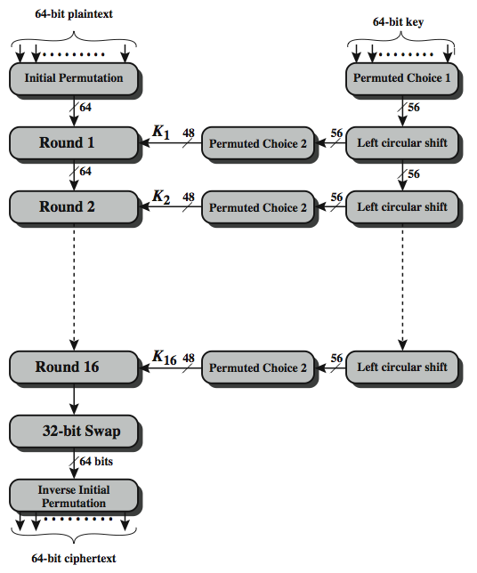
DES Encryption Overview

Slide 23
There are two inputs to the encryption function : plaintext(64bits) &key(56bits)
64bit plaintext passes through as initial permutation(IP) that rearranges the bit to produce the permuted input
Followed by a phase consisting of 16 rounds of same function, which involves both permutation &substitution functions
Output of the 16th round->64bits that are a function of i/p plaintext &key
Left &right halves of the o/p are swapped to produce preoutput
Preoutput passes through permutation(IP⁻¹) to produce 64bit ciphertext

Slide 24
Right hand side->56bit key passed through a permutation function
For each 16rounds,a subkey(Ki)is produced by the combination of a left circular shift and a permutation
Permutation func is same for each round but a diff subkey is produced because of repeated shifts of the key bits

Slide 25
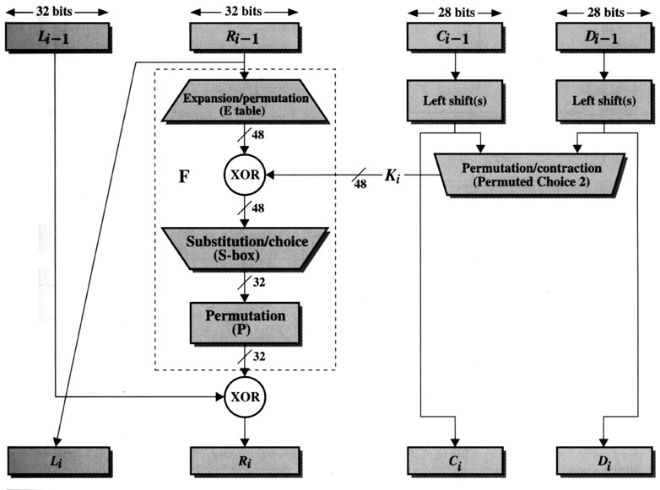

Slide 26
64 bit plaintext is divided into 2 halves Li-1 and Ri-1 ,each of 32 bits
Li=Ri-1
Ri=Li-1 xF(Ri-1,Ki)
F is given as an internal structure
32 bit in the right half undergoes expansion and permutation and generates 48bit.Done by duplicating some bits(16 bit)
Result is then combine with subkey Ki of 48bits using XOR operation

Slide 27
After mixing subkey,it produces 48bit which is divided into 8-6bit pieces and given as input to Sboxes.
Each S-box has an i/p of 6bit and produces a 4bit o/p, produced based on S-box tables
S-boxes provide the core of security
Thus S-box generate 32bit o/p
o/p of th s-box is given to fixed permutation P-Box
Then finally this 32bit and Li-1 are XOR ed and produce Ri

Slide 28
Initial Permutation
58 50 42 34 26 18 10 2
60 52 44 36 28 20 12 4
62 54 46 38 30 22 14 6
64 56 48 40 32 24 16 8
57 49 41 33 25 17 9 1
59 51 43 35 27 19 11 3
61 53 45 37 29 21 13 5
63 55 47 39 31 23 15 7
Table specifies the input permutation on a 64-bit block.
The first bit of the output is taken from the 58th bit of the input; the second bit from the 50th bit, and so on, with the last bit of the output taken from the 7th bit of the input.

Slide 29
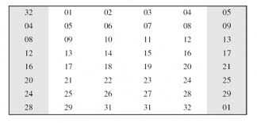
Expansion permutation

Slide 30
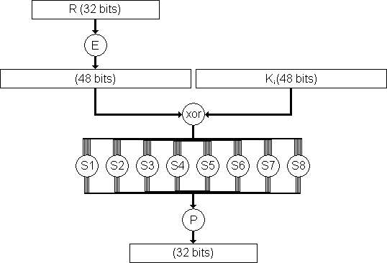
S-Box

Slide 31

DES – Inside an S-box
Each S-box has 4 rows, 16 columns
S-box 1
First and last input bits specify the row
Middle four input bits specify the column

Slide 32
DES – Inside S-box (cont)
S-box entry is the four-bit output
Examples with S-box 1
011001 ⇒ row 1, column 12 ⇒ 9 = 1001 (output)
110010 ⇒ row 2, column 9 ⇒ 12 = 1100 (output)
000011 ⇒ row 1, column 1 ⇒ 15 = 1111 (output)

Slide 33
Final Permutation(IP⁻¹)
40 8 48 16 56 24 64 32
39 7 47 15 55 23 63 31
38 64 61 45 42 26 2 30
37 5 45 13 53 21 61 2 9
36 4 44 12 52 20 60 28
35 3 43 11 51 19 59 27
34 2 42 10 50 18 58 26
33 1 41 9 49 17 57 25
The final permutation is the inverse of the initial permutation; the table is interpreted similarly.

Slide 34
Details Of Single Round
The left and right halves of each 64bit intermediate value are treated as separate 32bit quantities ,Land R
Li=Ri-1
Ri=Li-1 xF(Ri-1,Ki)
Round key Ki is 48bits
R i/p is 32 bits
R i/p is first expanded to 48bits by using a table that defines a permutation plus an expansion that involves duplication of 16bits of Rbits

Slide 35
Resulting 48bit are XOR ed with Ki
48bit result passes through a substituion func that produces a 32bit o/p which is then permutted
Substituion consists of 8 S-boxes,each of which accepts 6bits as i/p and produces 4bits as o/p

Slide 36
DES – Round 1
Input block (64)
L₁ (32)
R₁ (32)
EP
XOR
Subkey₁
S-box
P-box
XOR
L₂ (32)
R₂ (32)
Output block (64)

Slide 37

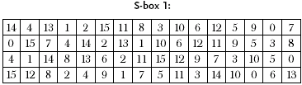
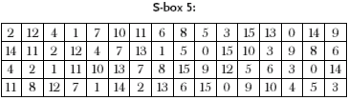
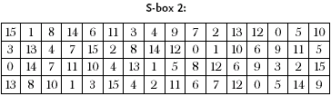
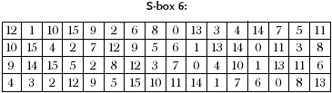
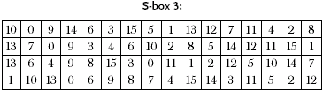
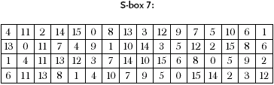
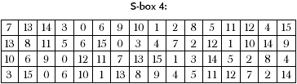
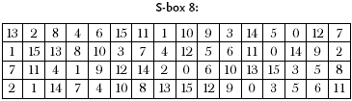
DES – S-boxes

Slide 38
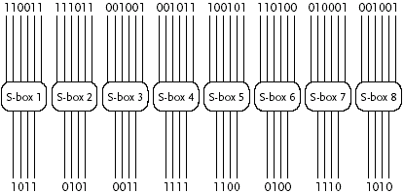
DES – S-boxes Example

Slide 39
Key Generation
64 bit key is used as i/p to the algm
Key are numbered from 1 to 64,every eighth bit is ignored
Key is first subjected to a permutation
Resulting 56bit key is then treated as 2,28bit,labelled C0 and D0
At each round Ci-1 and Di-1 are separately subjected to circular left shift
Shifted values will be i/p to the next round
They also serve as i/p to permutation choice

Slide 40
Actually size of the key is same as that of plaintext
Here it is 64bit
Among that 56bits are selected by pci.The remaining 8bits are either discarded or used as parity check bits

Slide 41
DES Key Schedule
forms subkeys used in each round
  initial permutation of the key (PC1) which selects 56-bits in two 28-bit halves
  16 stages consisting of:
    rotating each half separately either 1 or 2 places depending on the key rotation schedule K
    selecting 24-bits from each half & permuting them by PC2 for use in round function F

Slide 42
Subkey Rotation Table
Round no:1 2 3 4 5 6 7 8 9 10 11 12 13 14 15 16
No of bits:1 1 2 2 2 2 2 2 1 2 2 2 2 2 2 2
to rotate
Here the subkey generated for each round should be rotated in the order given in the above table
Eg:For round3,key is generated by rotating 2bit(left shift)
Simillarly for all rounds

Slide 43
DES Decryption
decrypt must unwind steps of data computation
with Feistel design, do encryption steps again using subkeys in reverse order (SK16 … SK1)
  IP undoes final FP step of encryption
  1st round with SK16 undoes 16th encrypt round
  16th round with SK1 undoes 1st encrypt round
  then final FP undoes initial encryption IP
  thus recovering original data value

Slide 44
Avalanche Effect
- key desirable property of encryption
alg where a change of one input or
key bit results in changing approx
half output bits

